Slide 1



Day 10
contact@anubhavtrainings.com
ABAP RESTFUL APPLICATION PROGRAMMING

Slide 2

Agenda – Day 10
Multi-dimension modeling continue
Introduction to Node JS
Functions and Rules
NPM – Node package Manager
Sequence diagram
Global Module
Middleware
Introduction to SAP UI5 tooling
Working with YML files in SAP UI5
Initialize UI5 project
Deployment to on premise
Closing note

Slide 3
Multi-Dimension Modeling
Data analytics is very important for businesses to know about the ongoing track of the transactions w.r.t the master data. Using data analytics the decision makers in our company take critical actions based on the overview of the data. The cds views are key ingredients to build data analytics in SAP systems.
Use Case
In our company we have the sales data maintained, my business wants to analyze this massive sales data and produce some insights about
Total sales in each currency per country
Total sales in each currency per Customer
Total sales in each currency per product
1. Total sales in each currency per category

Slide 4
QueryBrowser
ZC_bkl_xx_SLS_ANA
@Analytic.query
Zco_bkl_xx_sales
#CUBE
Aggregating the measure
Zi_bkl_xx_product
Zi_bkl_xx_bupa
Zi_bkl_xx_sls
Zi_bkl_xx_prod_text
Snwd_texts
Snwd_pd
Snwd_bpa
Snwd_ad
Snwd_so
Snwd_so_i

Slide 5

What is Node JS
Node is an open-source, Cross Platform, Java script runtime environment and used for executing Java Script code outside web browser.
Node.js is a great web framework for beginners because it works great for data-intensive applications, like streaming and real-time apps, and Node.js makes it east to start building backend.
Applications
Build Application Logic
Web Server
Send Email
DB lookups
Automations
Outputs
Host Web Apps
Server
Java
ABAP
Client
Java Script
Node JS
Java Script
www.anubhavtrainings.com

Slide 6





Important Rules
JS is a case sensitive programming language
Every statement ends with semi-column
Every variable or function follows JS naming convention (camel-case). The first letter is small and next consecutive word, first letter is capital.
Iloveindia → iLoveIndia mylifeiscool → myLifeIsCool
An array is a collection of values, each value is an item of an array. The index of first item always starts with zero (0)
Objects are like structures to contain multiple fields of different kinds
{ “propName” : value , “PropertyName” : value …. }
Java Script Object Notation – JSON https://jsonlint.com/
Array
Item 0
Item 1
Item …
100009 | Anubhav | 5000 | USD
www.anubhavtrainings.com

Slide 7
Functions
There are 2 types of functions
Namedfunction
var functioName = function(params…){
--code
return ;
}
Anonymous function
function(params…){
return ;
}
www.anubhavtrainings.com

Slide 8
Sequence Diagram
UI
Module
Synchronous – Java, ABAP, C, C++
w
async
Util (in-built)
ASynchronous – JavaScript
Callbacks
Promise
www.anubhavtrainings.com

Slide 9
NPM – Node Package Manager
NPM For Node JS = maven For Java
package.json = pom.xml
The world’s Largest Software Registry (Library)
This registry contains over 8.5mn code packages.
Open-source developers usage npm to share software.
Many organizations also use npm to manage their development – SAP - @sap
https://www.npmjs.com/
JS is asynchronous Non Blocking Programming language. Also is an event driven programming language.
Server
Node JS
Client
Mobile, Browser
Port
www.anubhavtrainings.com

Slide 10
Access Global Node JS Modules
The command to download the modules from NPMJS.com is
npm install modulename
Keep the module within the project
Keep the module globally in your system so all the projects can share it ➔ npm install –g <modulename>
If there is a utility, command line tools we install them globally
package.json
project
project
project
local
module
global
global
Package.json file
Information about our project name, author, version
All the dependencies required by this node project
When we deploy our project in another system/machine we can use npm install command
module
www.anubhavtrainings.com

Slide 11
Steps to initialize a fresh node project
Run command npm init – Creates a new node project
Answer simple questions and project gets created
As we mentioned that index.js is going to be my starring file, lets create the same
We can just add some code to index.js
To test our first node project, we can use a command called node .
Phase 2 – Create a webserver and microservice using ‘express’
Install express module and add that as dependency also to our project npm install express –save
You can check package.json and you will find dependencies
Use express module to create web server (refer index.js file)
Exercise:
Prepare a sample JSON payload for demo vendor data, and return that with endpoint /vendors
Create a new end point with /vendor/:id and just check in a collection of vendors if there is a vendor with this id passed by browser, and return that single vendor record
https://stackoverflow.com/questions/39632667/how-do-i-kill-the-process-currently-using-a-port-on-localhost-in-windows
www.anubhavtrainings.com

Slide 12
Middleware
We can include extra functionality to our express server as middleware. There are many usage of adding middleware.
Client
middleware
/vendors
Req
/customer
/orders
ppp.use(middlewarename)
https://yeoman.io/generators/
Exercise: Deploy our Node JS app to CF by adding manifest.yml and test the entire app
Check authorization
Accept special payloads json
Add security
…
www.anubhavtrainings.com

Slide 13
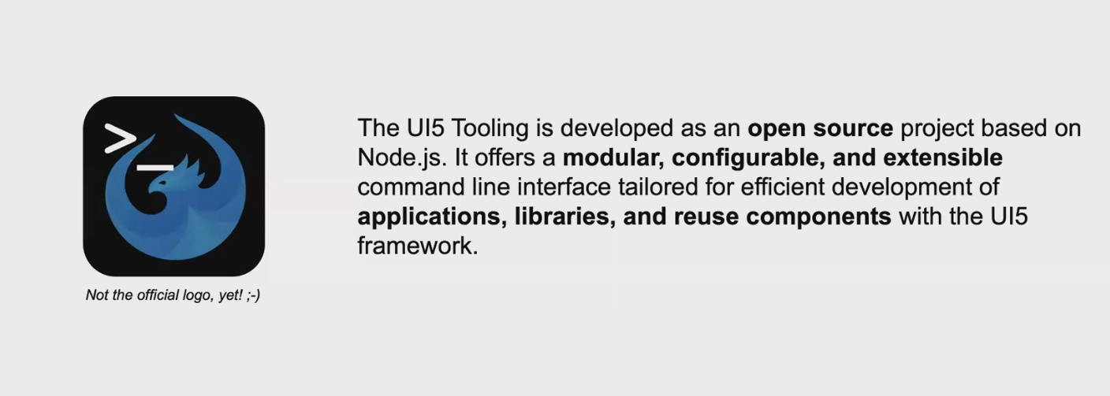
UI5 Tooling
www.anubhavtrainings.com

Slide 14
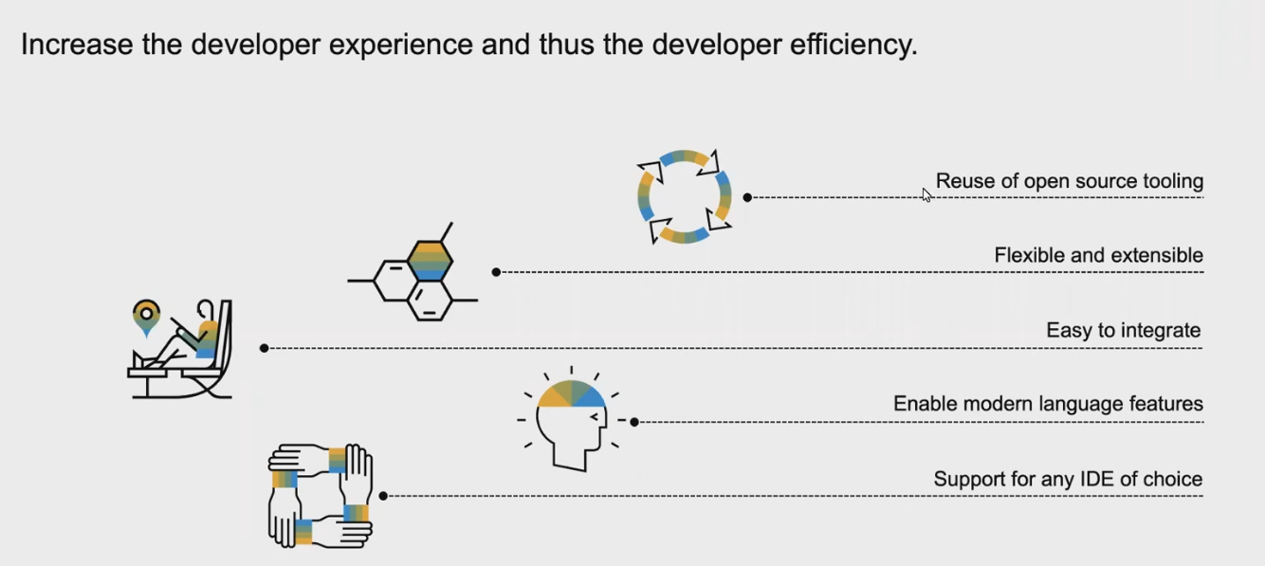
Motivation
www.anubhavtrainings.com

Slide 15
Get Started
UI5 CLI is a node module which you need to install in your PC for local development, In the BAS its already installed.
npm install –g @ui5/cli
2. We need to now add a file named ui5.yml file which tells the CLI about our project e.g name, type
ui5 init
3. Now we can start the UI5 Server
ui5 serve
Latest tooling – fiori run
fiori run allows you to pass additional configuration
www.anubhavtrainings.com

Slide 16
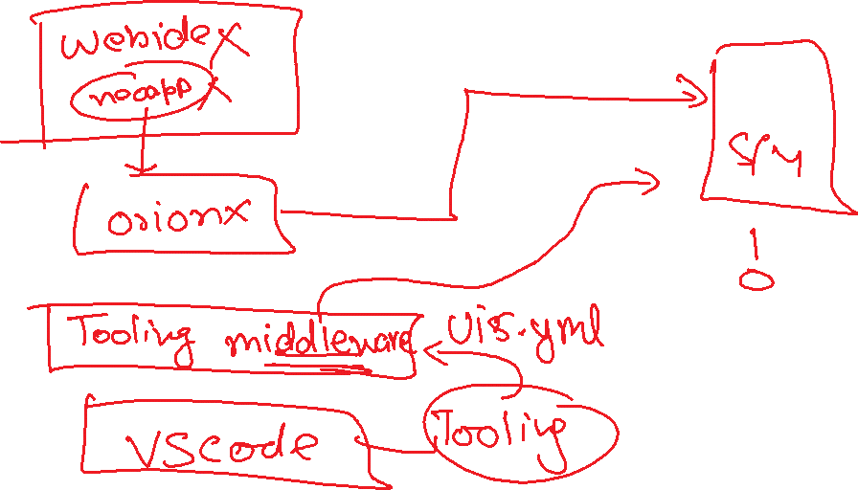

Slide 17
Build Process & Component-preload.js
In a typical Fiori App, we have verity of files inside our project (XML, Fragments, Controllers, Formatters, JS), When we start our project, all these files are served by Server sequentially, which means it has a synchronous loading. When browser download these files individually, it takes a while to download them. So the total booting time of our app is equals to the sum of time of each file.
Controller -3ms
Controller-dbg -3ms
XML.view – 5ms
XML.view-dbg – 5ms
20 ms
Component-preload.js
Formatter – 2ms
Formatter-dbg – 2ms
Component.js 10ms
Component-dbg.js 10ms
2. Anubhav, where we run our fiori project in webide, ui5 serve, or launchpad, I get an error Component-preload.js not found, how to solve it
3. Each file needs to be converted to minified version, which will take less time to load.
ui5 build command can be used to package our project, which creates a dist folder. The Component-preload.js is a minified and dirtified version of our entire app code.
www.anubhavtrainings.com

Slide 18
Advance Fiori Tooling
Add following Dependencies
"@sap/ux-ui5-tooling“ - It already has @sapui5/cli + Additional middleware's
"@sap/ux-specification”
2. Additionally add below configuration
"ui5": {
"dependencies": [
"@sap/ux-ui5-tooling"
]
}
3. Test fiori run Command
Advantage – Extra middleware's, Can run with multiple configurations
https://npm.io/package/@sap/ux-ui5-tooling
www.anubhavtrainings.com

Slide 19
Advance Tooling
App Reload Middleware
Loading UI5 from CDN with Server Proxy
Connecting to your OData Server (Replace of destination file/neo-app.json)
Running SAP UI5 reference locally w/o internet
Deploying App to SAP S/4HANA System
Run command fiori add deploy-config
Add configuration and change as per need
We need to add user name password in an .env file which the config will read while deployment
Command to deploy - ui5 build --config ui5-deploy.yaml
www.anubhavtrainings.com

Slide 20
Title
Browser
Fiori App is Running
http://localhost:8081/
sapserver.sap.com
UI5 SDK
UI5 Tooling
Server - express
fiori-tools-proxy
dest
www.anubhavtrainings.com

Slide 21
Question
Have you ever waited for an ABAP developer to provide you OData Service so you can start the Fiori App development?
Did you ever face a challenge of Fiori App development because the backend was down, OData was down or not working.
Testing an application w/o backend connectivity.
Did you tried to create prototypes with working dataset w/o o data being ready.
SAP Fiori Mock Server
Generator
Mock Server
Fiori App
home
A server which is provided by SAP as a dependency, we can implement a mock server which provides hardcoded data as odata service.
data
Server
Power house
www.anubhavtrainings.com

Slide 22
Title

Slide 23

End of Day 10
Trainer: Anubhav Oberoy

Slide 24
Trainer: Anubhav Oberoy

Slide 25
THANK YOU
If you cannot do
great things, do small things in a great way.
Anubhav Oberoy
https://www.anubhavtrainings.com

Slide 26


We’re committed to empower you to be
Most Desirable Resource
through powerful training solutions.
We build the workforce of the future.
250+
Corporate Clients
30,000+
Learners Trained
25000+
Learners Placed
FREE WEBINARS
Sign up for free webinars with industry experts every fortnight!
Enroll Now!
Contact us today!
https://anubhavtrainings.com/

Slide 27




More from AnubhavTrainings.com

